Slide 1



TPO & Customer Targeting Recommendation
Data & Analytic, D&T
Student: Votana SREY
Advisor: Chanto TENG
Supervisor: Kanika MONTHA
Defense Date: 7 June 2023

Slide 2

CONTENT OF TODAY
HEINEKEN OpCo BASIC INFO
1
2
PROJECT INTRODUCTION
STATE OF THE ART
3
ANALYSIS & GENERAL CONCEPT
4
CONCLUSION
5
2

Slide 3


1 HEINEKEN Cambodia Basic Info
D&T Team

Slide 4
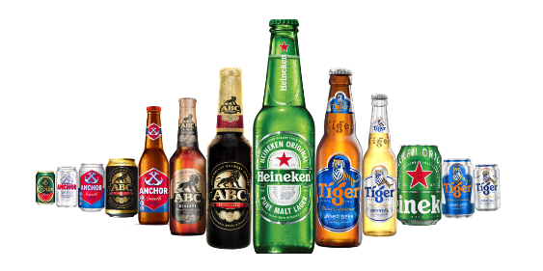




Data Management sets the direction to reach our goal and safeguards our journey
OUR PURPOSE
We brew the joy of true togetherness to inspire a better world.
OUR VALUES
Passion for consumers & customers
Courage to dream & pioneer
Care for People and Planet
Enjoyment of life
Location
Tiger Beer Road, Robos Angkagne Village, Sangkat Prek Eng, Khan Chbar Ompov, Phnom Penh, Cambodia
Contact
+855 96 555 1777
Contact Us | HEINEKEN Cambodia
Website
Our Company | HEINEKEN Cambodia
Careers | HEINEKEN Cambodia

Slide 5

2. PROJECT INTRODUCTION
Trade Program Optimization & Customer Targeting Recommendation

Slide 6



PROBLEM STATEMENT
Before produced this project, we have received some problematics from the stakeholders and business requirement analysis.
HARD TO TARGET THE RIGHT CUSTOMER
When the trade marketing team is doing to the target customer group for their program and activation. They don’t have the target customer list and they don’t know much who they should target to.

Slide 7


Trade Program Optimization
is the initiative project from Data and Analytic team to support the trade marketing and sale team to optimize the key performance indicator, trade program itself, and increase the sale volume of the company as well.

Slide 8




PROJECT’S OBJECTIVE
To finetune customer targeting in order to leverage the effectiveness of the trade term program. To apply analytics model in order to uncover any hidden gaps in master data and trade term is the selected case for this study. Thus Data & Analytic Team has come up an idea to assist TM to solve this out to increase the sell volume and company KPI as well. The objectives would be:
END
Objective 1:
Improve the trade program targeting effectively
Objective 2:
Increase the sell volume and profit generate by trade program optimization model
Objective 3:
Understand the customer’s performance & behaviors
START

Slide 9
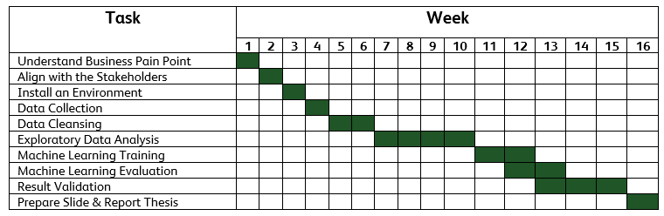
PROJECT ROADMAP & PLANNING
Current Process
Future Process
Understand the gaps of current scope both business and data
Propose recommendation to business on the targeting gaps
Propose recommendation to Data Team for a better data strategy that can fill the gaps
Customer Persona and other master data information to be collected and maintained
Support “lead digital and ecommerce” ambition
Current scope: understand the current status first
Post the ideal scenarios, what should be the best way in optimizing the program
Data Warehousing (DM) Data Model (DM) Analytics Model (DA)
Forward looking into what are the new fields (new info), how the fields are needed, what will be of use, how to leverage on them
Think outside the box, this is an exploratory study. What are the data we should further collect, maintain, how these data will be beneficial, what are the new insights it will bring
1
2
3
4
PROJECT PLANNING
The project has 4 months in duration. That’s starting from 15 January 2023 to 15 May 2023. This table below illustrate the project planning and listing the tasks from A to Z.

Slide 10

3. STATE OF THE ART Listing down the Methodologies, Hypothesis and Research Questions is being used in the project

Slide 11





METHODOLOGY
Well-defined problem &
Data Collection
Data
Cleansing
Exploratory Data
Analysis
If the Machine Learning model is not performed well.
Model
Evaluation
Model
Development
Data
Preprocessing

Slide 12
HYPOTHESIS & RESEARCH QUESTIONS
To apply analytics model in order to uncover any hidden gaps in master data and trade term is the selected case for this study. We are currently having the hypothesis to test it out:
Null Hypothesis (H0): Improving the trade program and customer targeting will NOT increase the sale volume and profit of revenue company KPI.
Alternative Hypothesis (H1/HA): Improving the trade program and customer targeting will increase the sale volume and profit of revenue company KPI.
Research Questions
What’s the current process of doing trade program targeting?
What are the metrics to analyze on trade program performance and correlation between customer targeting?
​How can master data maintain to support the trade program targeting?
Which is the best model to implement with customer targeting recommendation for trade marketing?

Slide 13
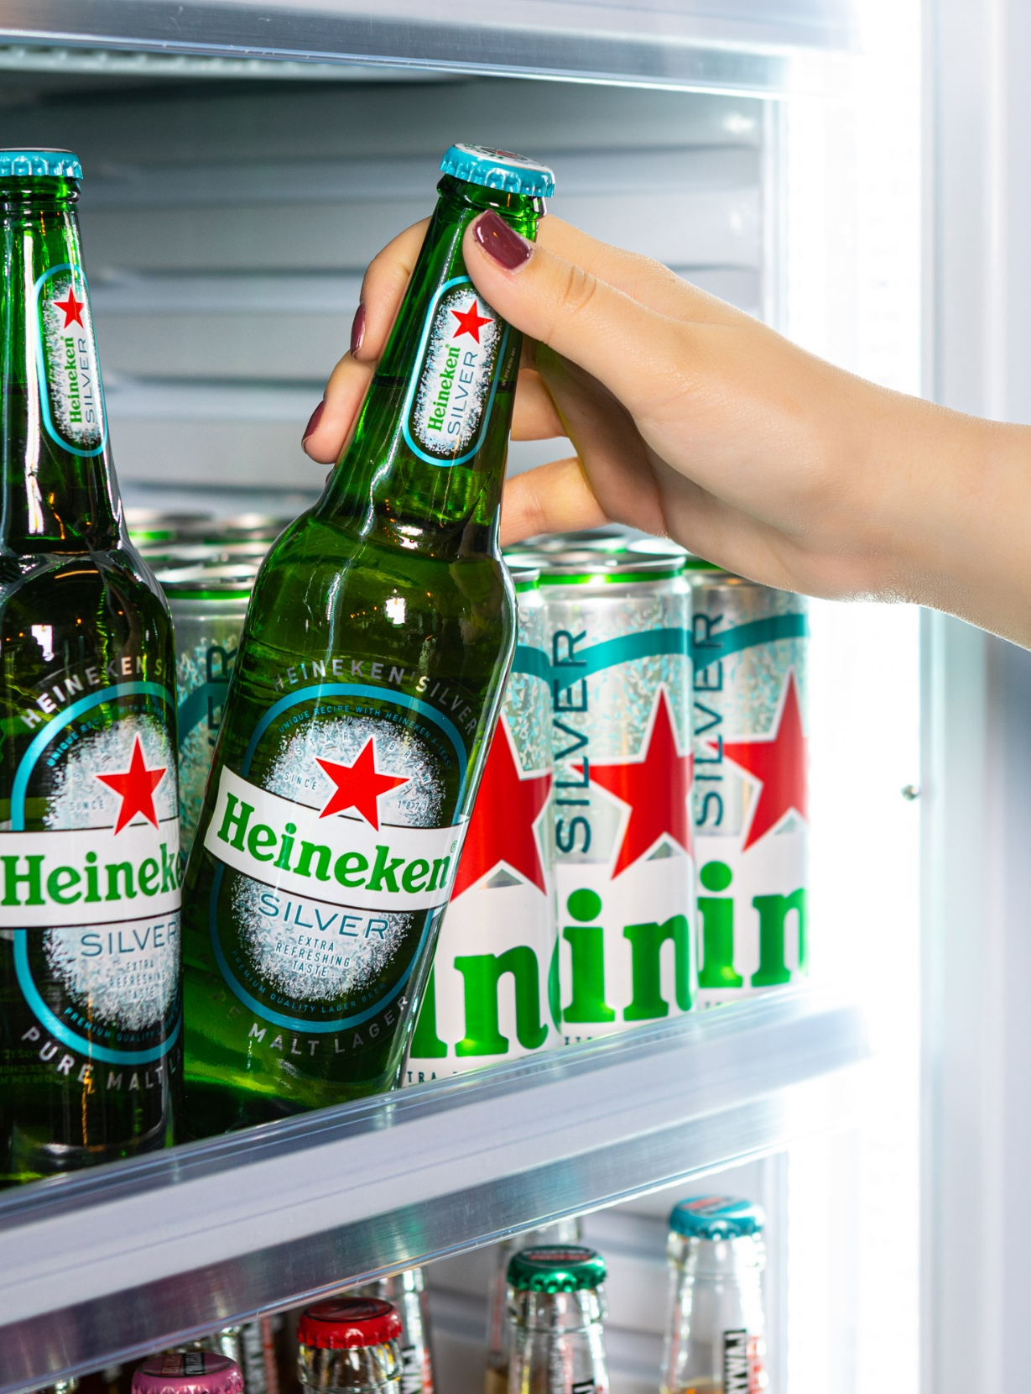
4. ANALYSIS & GENERAL CONCEPT Listing down the technologies, tools and project pipeline are being used.

Slide 14














TECHNOLOGIES & TOOLS
LANGAUGES
TOOLS
Python
SQL
DAX
MS SQL Server
Anaconda
VS Code
MS PowerBI
MS 365
LIBRARIES
Scikit Learn
Matplotlib
Seaborn
Pandas
Plotly
NumPy

Slide 15






DATA COLLECTION
Total Outlet Sample (Unique)
1500
Est. Order Transactional Data
9000
Total Features
45
Data Source / Source System
Data Integration
Data Warehouse
SSIS
ETL
DWH_HCAM
Flat file
SEM
DOT (Tich Tos)
Base JDE
Staging
Server
OutletMasterSEM
Dynamics NAV 2015 (DIS)
Staging
Archive
DIS

Slide 16
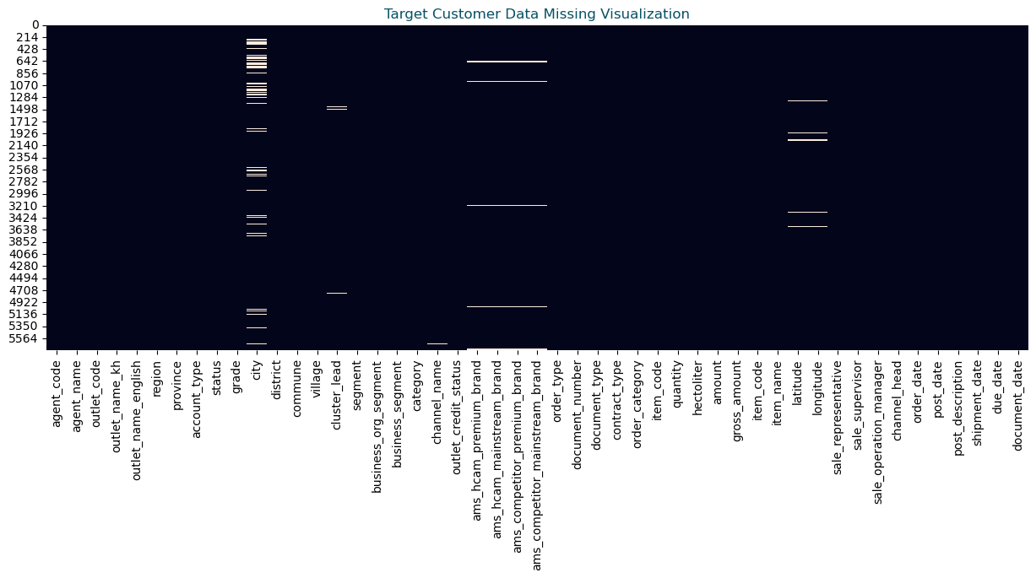
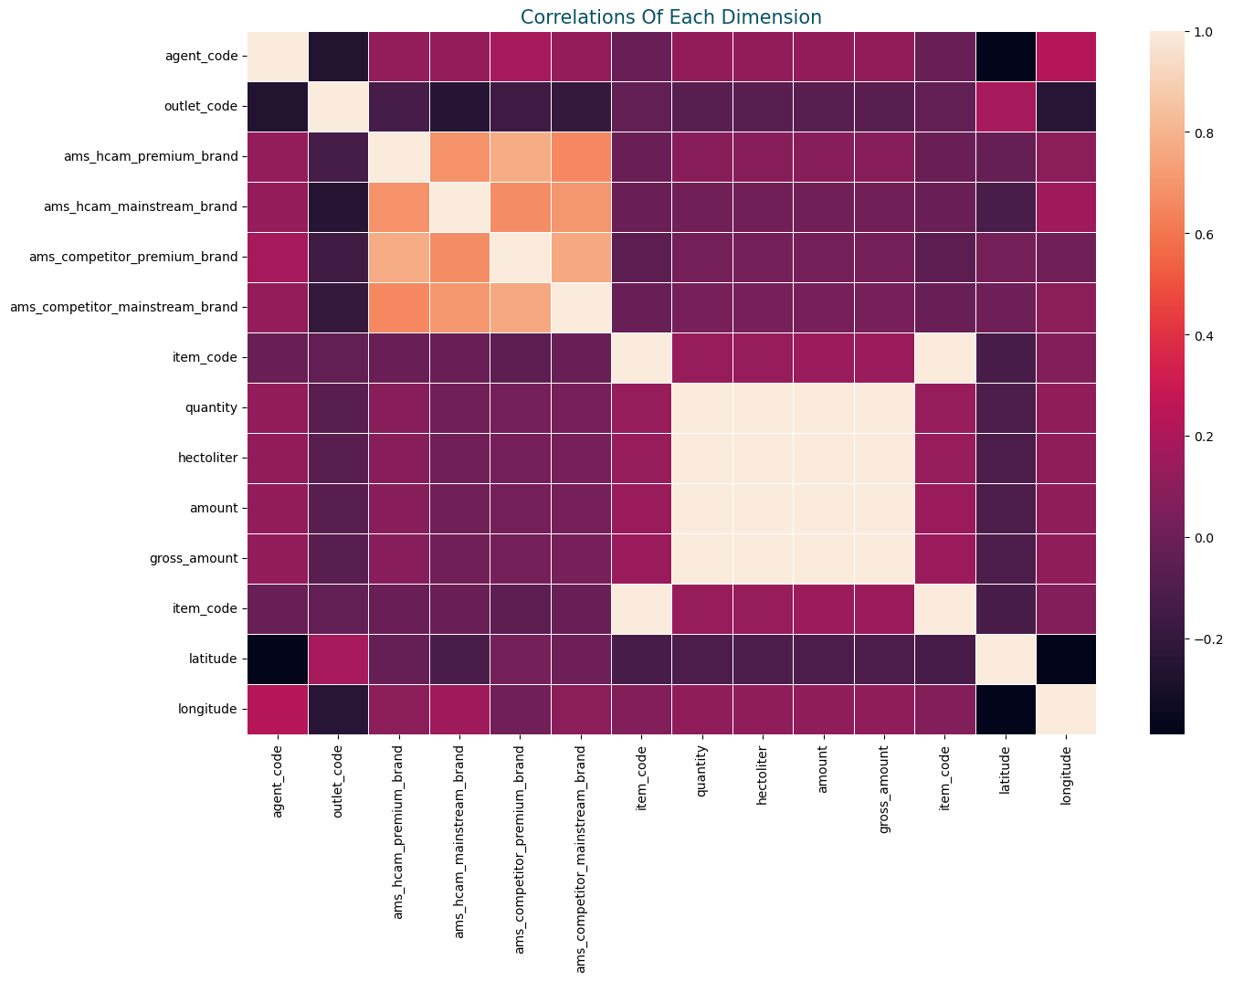
DATA CLEANSING
The Data Cleansing is here to validate the features and sample. This visualization indicates the NULL amount of each data point of the whole data set and its basic info of it. There is no many NULL sample and we already validate and custom all the data types to be right before proceeding to the next step.

Slide 17



EXPLORATORY DATA ANALYSIS
In this part, we are going to extract the data from the data warehouse of outlet transaction data to see the performance and we are going to explore the data in order to gain more insights from the data and the trade marketing insight analysis as well.
Customer Performance Analysis
Customer Behavior Analysis
Customer Segmentation
In this part, we are going to analyze and see the performance of the targeted customers that exists in the trade marketing team list. And then we can do the analyze on the top performers and bottom performers who selected in the sample targeted.
In this part, we are going to analyze on the top performers and bottom performers to get the metrics for really for ML model.
In this part, we train the model and selected features and metrics from the customer behavior analysis. Therefore, the customer segmentation models will be built from there.

Slide 18
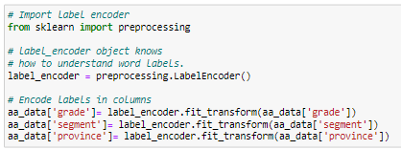
DATA PREPROCESSING
In this part, we are going to the process of transforming raw data into an understandable format for the machine learning model development.
To transform the categorical variable, we use the label encoder to make it out. Label Encoder is a technique that is used to convert categorical columns into numerical ones so that they can be fitted by machine learning models which only take numerical data.
Outlet Grade | After Label Encoder
Monitor | 0
Grow | 1
Defend | 2
Attack | 3
And then we have tried with another good data preprocessing methodology is One-Hot Encoding. ONE-HOT Encoding is a process by which categorical variables are converted into a form that could be provided to ML algorithms to do a better job in prediction. One hot encoding consists of replacing the categorical variable by different Boolean variables, which take value 0 or 1.
Outlet Code | Grade_Monitor | Grade_Grow | Grade_Defend | Grade_Attack
700100 | 1 | 0 | 0 | 0
700200 | 0 | 1 | 0 | 0
700300 | 0 | 0 | 1 | 0
700400 | 0 | 0 | 0 | 1

Slide 19
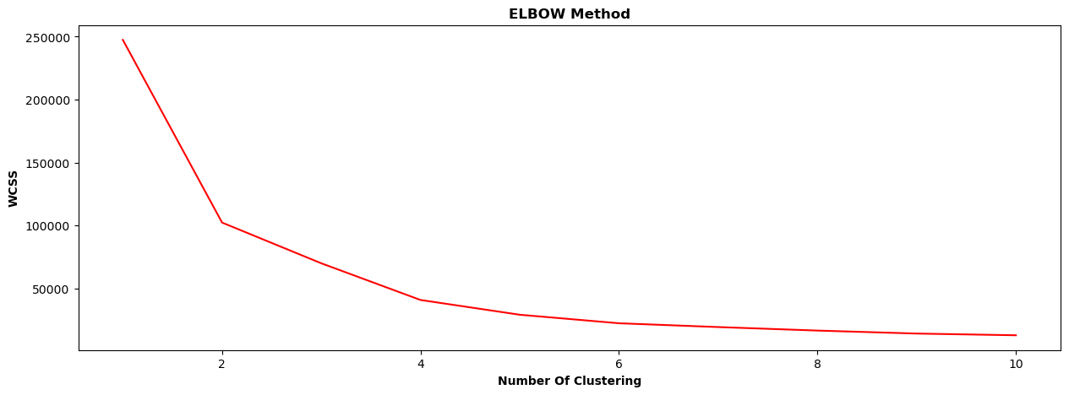
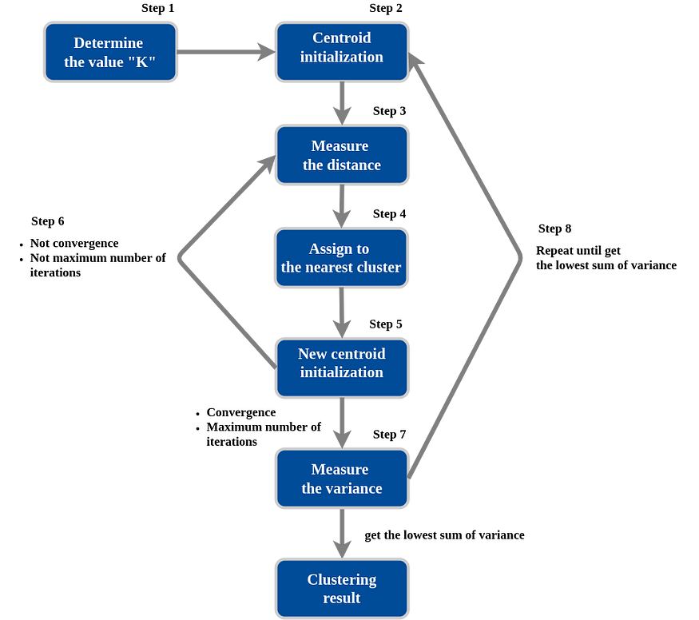
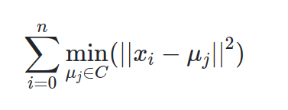
MODEL TRAINING ~ K-MEAN
In this part, we are going to train the machine learning model for clustering.
K-means clustering is a simple and elegant approach for partitioning a data set into K distinct, non-overlapping clusters. To perform K-means clustering, we must first specify the desired number of clusters K; then the K-means algorithm will assign each observation to exactly one of the K clusters:
The K-means algorithm clusters data by trying to separate samples in n groups of equal variance, minimizing a criterion known as the inertia or within-cluster sum-of-squares. The K-means algorithm aims to choose centroid that minimize the inertia, or within-cluster sum-of-squares criterion

Slide 20
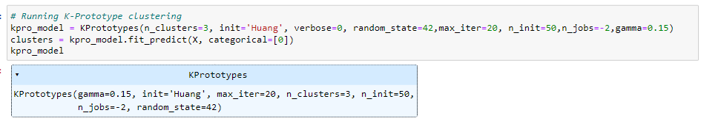
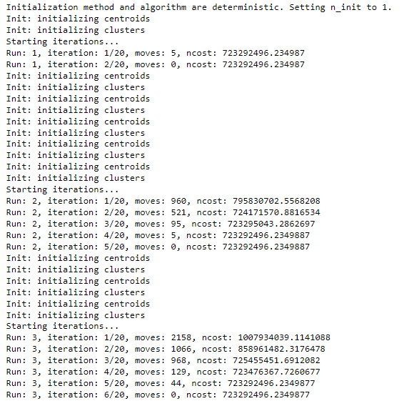
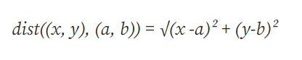
MODEL TRAINING ~ K-PROTOTYPE
In this part, we are going to train the machine learning model for clustering.
K-prototype algorithm is an ensemble of K-means and K-modes clustering algorithms.
It uses different distance metrics for numerical data and different distance metrics
for categorical datatype.
It is the sum of squared difference for each future pair, also known as L2 norm.

Slide 21
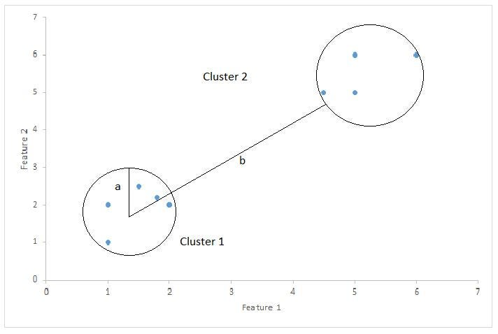
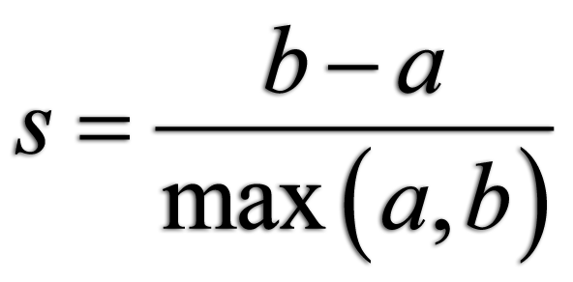
MODEL EVALUATION
In this part, we are going to evaluate the performance of machine learning model for clustering.
Silhouette Coefficient or silhouette score is a metric used to calculate the goodness of a clustering technique. We can also use the silhouette score to check the optimal number of clusters. In the above example, we can say that the optimal number of clusters is 2 as its silhouette score is greater than that of 3 clusters.
S is the silhouette coefficient of the data point i.
a is the average distance between i and all the other data points in the cluster to which i belongs.
b is the average distance from i to all clusters to which i does not belong.

Slide 22



MODEL EVALUATION
In this part, we are going to evaluate the performance of machine learning model for clustering.
K-MEAN
This is the performance of K-MEAN that we got around 80.3% of accuracy by using above methodology to evaluate.
80.3%
K-PROTOTYPE
This is the performance of K-PROTOTYPE that we got around 77% of accuracy by using above methodology to evaluate. This is a good performance we compare to the previously.
77.5%

Slide 23
CONCLUSION
5
INSIGHTFUL RESULT, EXPERIENCES, CHALLENGES,
AND FUTURE PERSPECTIVE

Slide 24
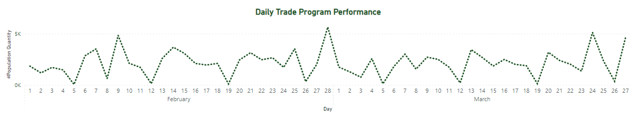




INSIGHTFUL RESULT
In this part, we are going to indicate the insightful result from the EDA and our model as well
The order trend increase mostly on Festi day and Saturday.
On Sunday, sale order mostly decrease during the program
Totally, the promotion should consider on Friday and Saturday

Slide 25
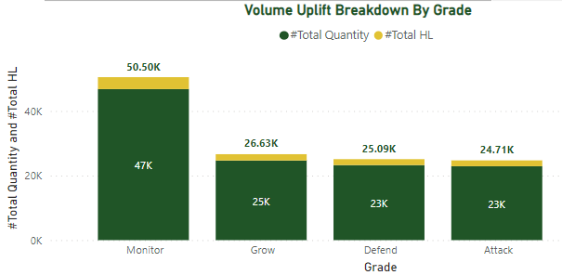


INSIGHTFUL RESULT
In this part, we are going to indicate the insightful result from the EDA and our model as well
MONITOR
Monitor is the outlet grade that got the most take care of from sale team very much. The outlet from this insight is monitor outlet grade got the top sale during the program.
GROW, DEFEND, ATTACK
Those outlet grade still got take care most especially defend and attack. Those three-outlet type are performed quite similar, but the root cause is probably from competitor attack and their geo from countryside.

Slide 26

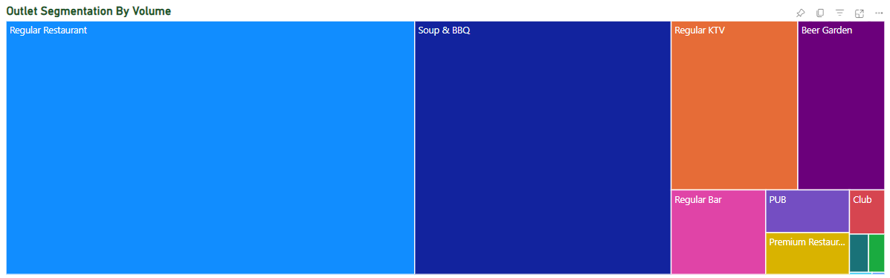
Regular Restaurant, Soup BBQ
Regular KTV and Beer Garden
INSIGHTFUL RESULT
There are many outlet segment defined by trade marketing team that allow and selected into the targeted list but only some of segmentation is targeted the right one. The insight is for next ON-TRADE program and the similar maganism should be considered on these 4 segmentation better than got the wrong target outlet group.
In this part, we are going to indicate the insightful result
from the EDA and our model as well

Slide 27

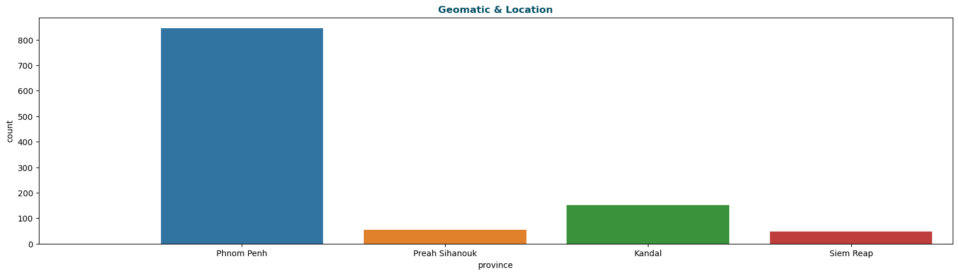
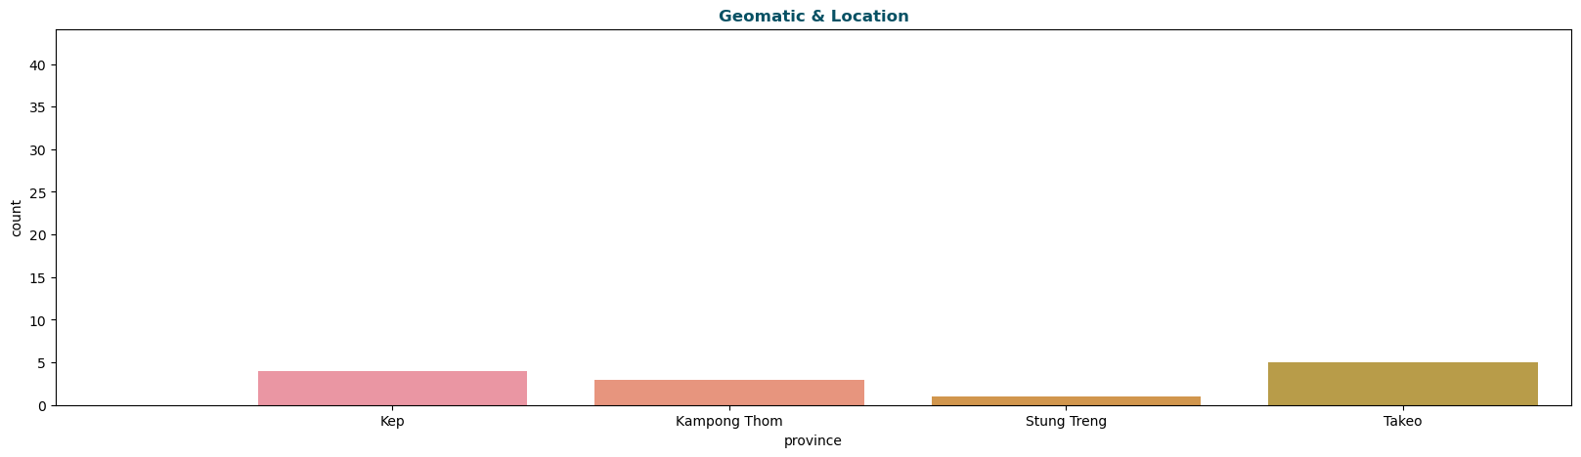
INSIGHTFUL RESULT
In this part, we are going to indicate the insightful result from the EDA and our model as well
TOP PERFORMERS ANALYSIS
LOCATION – TOP PERFORMERS
TOP performers here is defined by HIGH gross amount values.
The location is important for customer’s sale. Therefore, most of the top performers are got well-performed from Phnom Penh, Kandal, Preah Sihanouk and Siem Reap.
SEGMENT – TOP PERFORMERS
Segmentation is one of all for the target customer, Therefore most of the top performers' segmentation are from Regular Restaurant.
BOTTOM PERFORMERS ANALYSIS
Bottom performers here is defined by LOW gross amount values.
LOCATION – BOTTOM PERFORMERS
The bottom performer from Kep, Kampong Thom, Stung Treng and Takeo are NOT well-performed during the program
SEGMENT – BOTTOM PERFORMERS
Premium Restaurant is the segment that most of bottom performers got. To be noted, tiger is not premium band one for that segmentation.

Slide 28


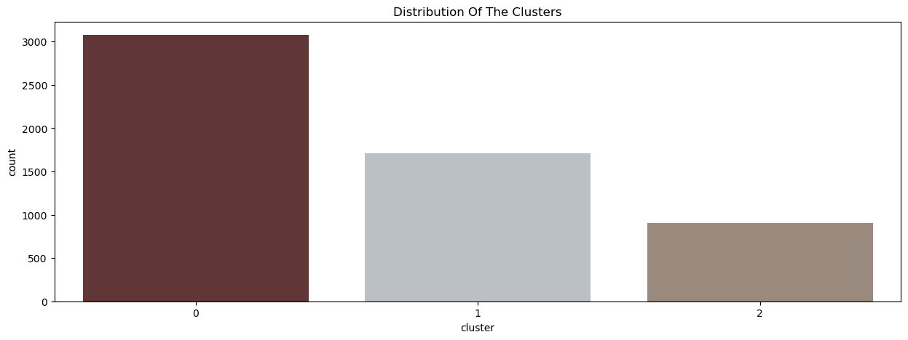
Targeted Customer Segmentation Result
INSIGHTFUL RESULT
In this part, we are going to indicate the insightful result from the EDA and our model as well
Cluster 0
Cluster 1
Cluster 2
Amount
HL
Province
Segment
Grade

Slide 29




EXPERIENCES
What I experienced from HEINEKEN
INTERNATIONAL WORK ENVIRONMENT
BUSINESS
ACUMEN
DATA
ANALYTICS
COMMUNICATION AND TEAMWORK
Learnt the international culture, HEINEKEN’s behavior and collaborate the teamwork to deliver the tasks on time and effectively.
New business model and process of revenue growth are really important points and keep improving and learning of this things to support the business and our customers.
Both, technical and analytic are really essential and data analytic team captaincy as well.
To delivery the tasks on time and effective, communication and teamwork is really main points and prepare the right strategy for communication to the right one as well.

Slide 30



THE CHALLENGES
The challenges from my view with HEINEKEN
PROJECT MANAGEMENT
LEADERSHIP COMMUNICATION
NEW ML ALGORITHMS
Manage a project and implement it in the giant company is not easy like that I did in the class. So, I put it as my challenge during implementing this project.
That’s a part of communication strategy to communicate to higher level to deliver the project on time and effective. So, from my view, that’s my challenge but my head and team really support on this very much.
There are many new machine learning algorithms to explore and learnt from that. That’s not a big challenge but there is just a little bit to fight with those thing.

Slide 31


FUTURE PERSPECTIVES
The TPO next actions and perspectives
WELL, DONE
Support “lead digital and ecommerce” ambition.
Maintain the master data to support the trade marketing team and sale team do the right target customer. ​
Implement more machine learning algorithms on the data sample and adding more data.

Slide 32
THANK YOU
Student: Votana SREY
Advisor: Chanto TENG
Supervisor: Kanika MONTHA
Defense Date: 7 June 2023

Slide 34
APPENDEX
D&T Team

Slide 35


Slide 36
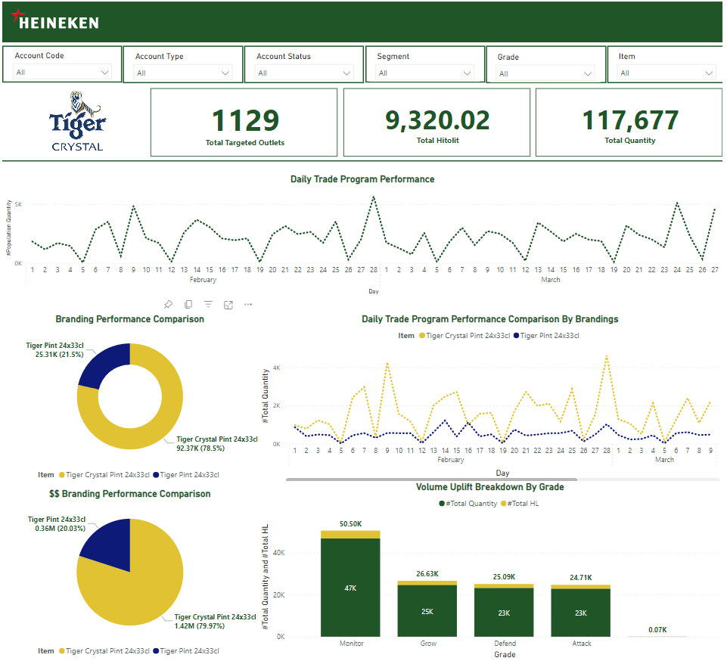

Slide 37
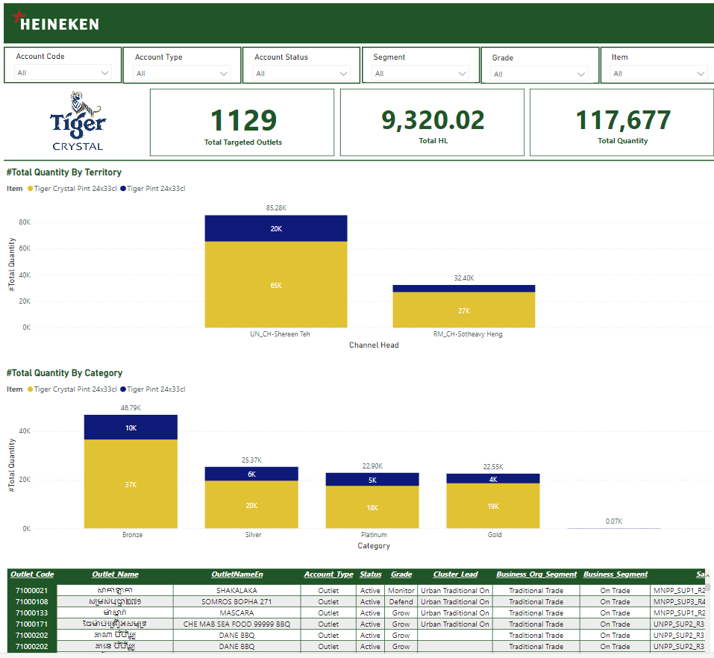

Slide 38
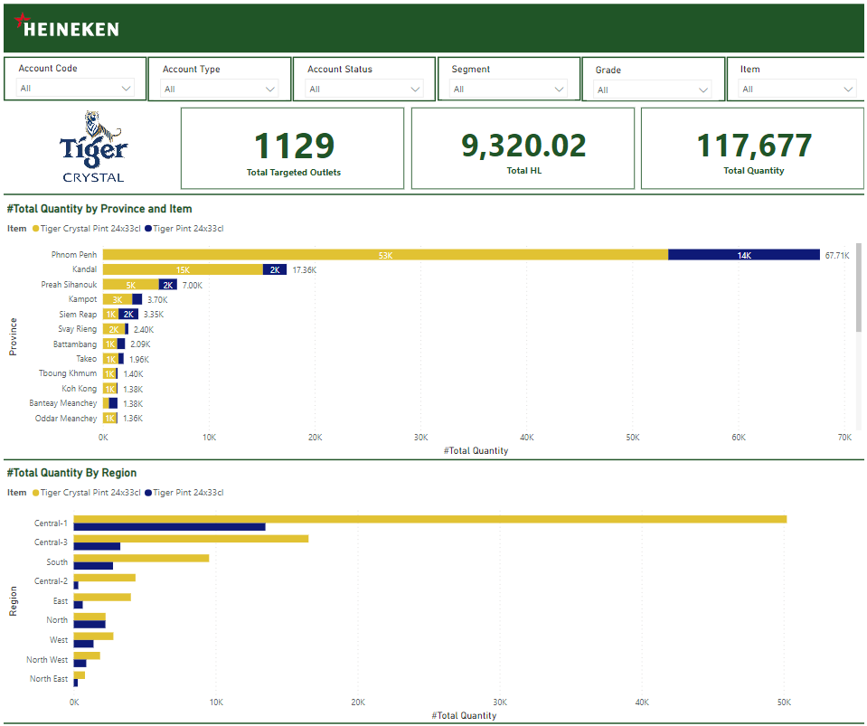

Slide 39
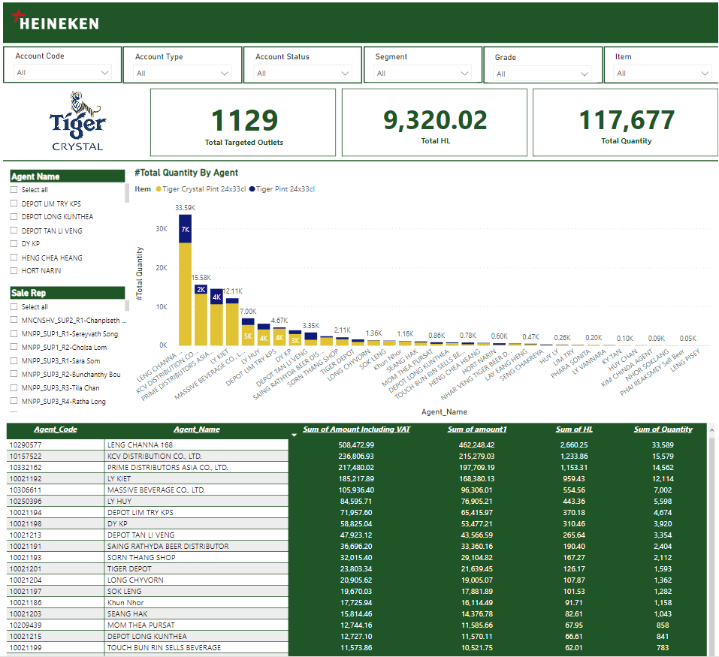

Slide 40
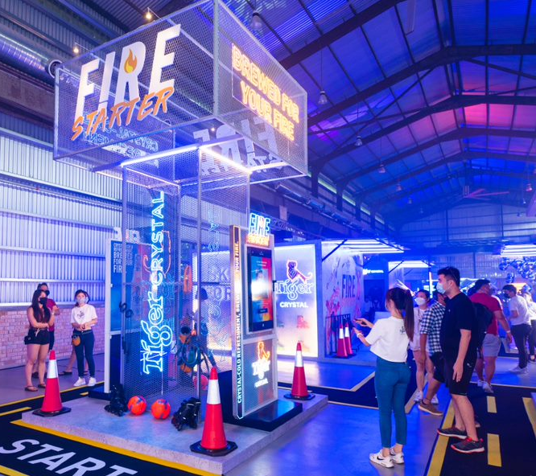


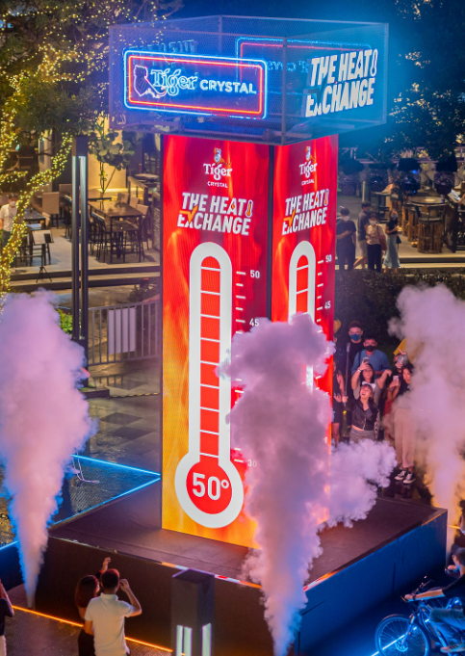
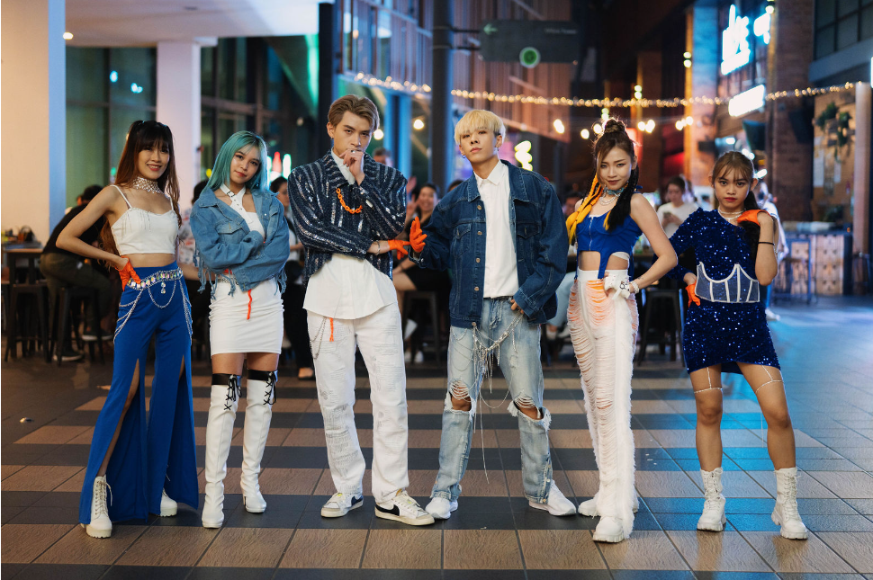

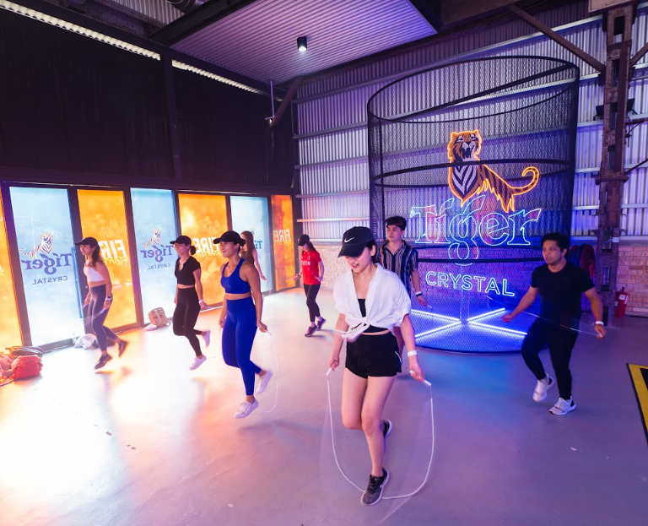
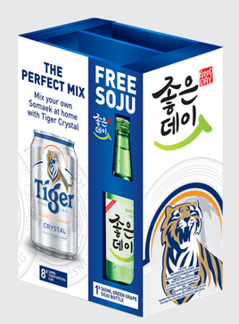
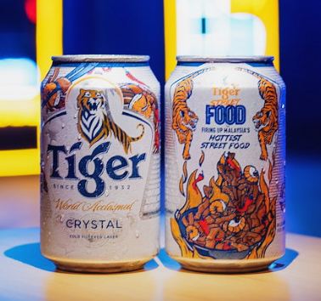

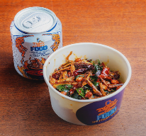
HEINEKEN’S Trade Program

Slide 41
OBJECTIVES
To finetune customer targeting in order to leverage the effectiveness of the trade term program. To apply analytics model in order to uncover any hidden gaps in master data and trade term is the selected case for this study. Thus Data & Analytic Team has come up an idea to assist TM to solve this out to increase the sell volume and company KPI as well. The objectives would be:
Improve the trade program targeting effectively
Increase the sell volume and profit generate by trade program optimization model
Understand the customer’s performance & behaviors
Improve the master data and data model & what the need to push master data help the trade program targeting.

Slide 42
METHODOLOGY

Slide 43

METHODOLOGY
In this part, we are going to extract the data from the data warehouse of outlet transaction data to see the performance and we are going to explore the data in order to gain more insights from the data and also the trade marketing insight analysis as well.
Trade Program Performance Analysis
Customer Performance Analysis
Customer Behavior Analysis
Customer Segmentation
Trade Marketing
Sale Operation
Route to Consumer
Route to Consumer

Slide 44
DATA COLLECTION
Data Source / Source System
Data Integration
Data Warehouse
SSIS
ETL
DWH_HCAM
Flat file
SEM
DOT (Tich Tos)
Base JDE
Staging
Server
OutletMasterSEM
Dynamics NAV 2015 (DIS)
Staging
Archive
DIS

Slide 45






DATA COLLECTION
Data Source / Source System
ETL Tool (Optional)
SSIS or Azure Factory
Flat file
SEM
Power BI
DOT (Tich Tos)
Base JDE
Staging Server
DWH Server
Users
Excel
Dynamics NAV 2015 (DIS)
Staging_Archive
OLAP Cube

Slide 46
DATA COLLECTION
Demand Forecasting
TradeCensus, Market Survey
Other Relevant Data
Sell Out
Agent, DIS
Inventory Mgt
GlassRun
Order Mgt
B2B
Commercial Data
TPO & Customer Targeting
Sale Data
Promotion, DOT
Market Share
Master Data
Sell In
Financial Data, Base JDE
POSM
SEM
Order Received, DIS
Vendor, Mendix
Customer Data
Item Data
Agent Data
Customer Data
PICOS
Asset
Activation

Slide 47
DATA COLLECTION
Demand Forecasting
TradeCensus, Market Survey
Other Relevant Data
Sell Out
Agent, DIS
Inventory Mgt
GlassRun
Order Mgt
B2B
Commercial Data
TPO & Customer Targeting
Sale Data
Promotion, DOT
Market Share
Master Data
Sell In
Financial Data, Base JDE
POSM
SEM
Order Received, DIS
Vendor, Mendix
Customer Data
Item Data
Agent Data
Customer Data
PICOS
Asset
Activation

Slide 48
DATA COLLECTION
Total Outlet Sample (Unique)
1500
Est. Order Transactional Data
2500
Total Features
45
List the Features
Agent_Code
Agent_Name
Outlet_Code
Customer_Name
OutletNameKh
OutletNameEn
Region
Province
Account_Type
City
District
Commune
Village
Segment
Business_Org_Segment
Business_Segment
Category
ChannelName
OutletCreditStatus
AMS_HCAM_Premium_Brand
AMS_HCAM_Mainstream_Brand
AMS_Competitors_Premium_Brand
AMS_Competitors_Mainstream_Brand
OrderType
Document No_
DocType
ContractType
OrderCategory
ItemCode
Quantity
HL
amount1
Amount Including VAT
itm_code
itm_des
level1_territory and Name
level2_territory and Name
level3_territory and Name
level4_territory and Name
Order Date
Posting Date
Posting Description
Shipment Date
Due Date
Document Date

Slide 49


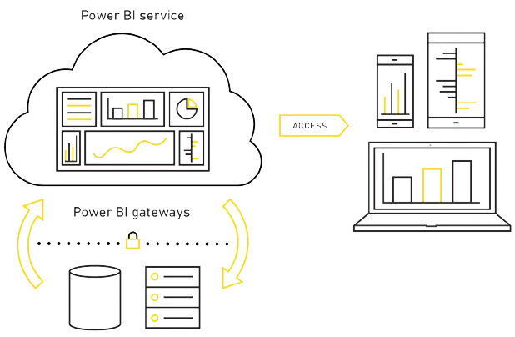
DASHBOARD ARCHITECTURE
Data Source
ETL Tool (Optional)
SSIS or Azure Factory
Dashboard Development
Machine Learning Model Deployed
Flat file
SEM
DIS
Staging Server
DWH Server
PBI Desktop
DOT
(Tinh Tos)
Used to secure data transfer between
on-premises data
User Access
PBI Service
PBI Gateways

Slide 50



TECHNOLOGY
LANGAUGES
TOOLS
Python
SQL
DAX
MS SQL Server
Anaconda
VS Code
MS PowerBI
MS 365
LIBRARIES
FRAMEWORKS
SKLearn
Matplotlib
Seaborn

